Slide 1

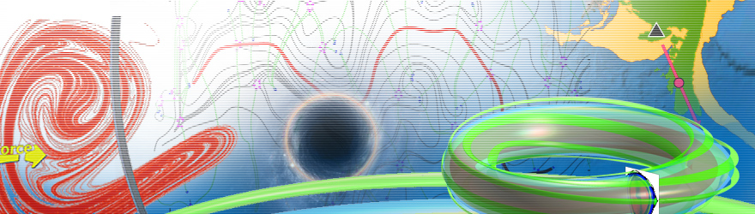
生物动力系统模拟
王冠宇 18665955633
wanggy@sustc.edu.cn

Slide 2
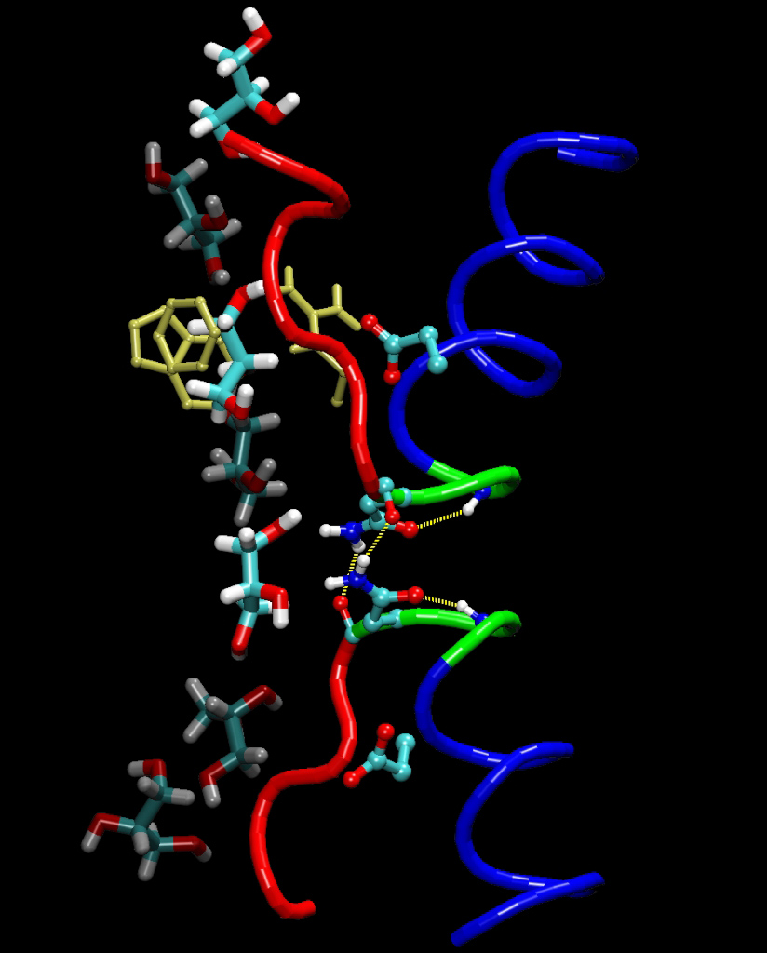
Molecular Dynamics Simulation (a brief introduction)

Slide 3
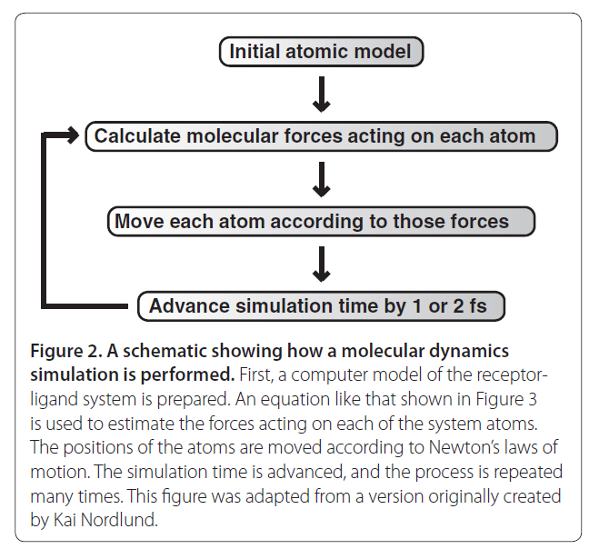
Steps

Slide 4
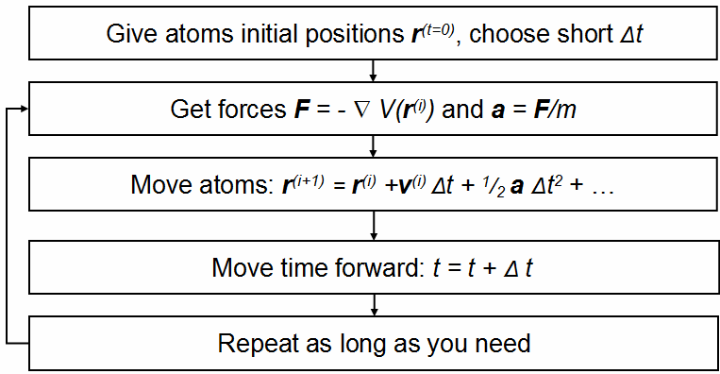
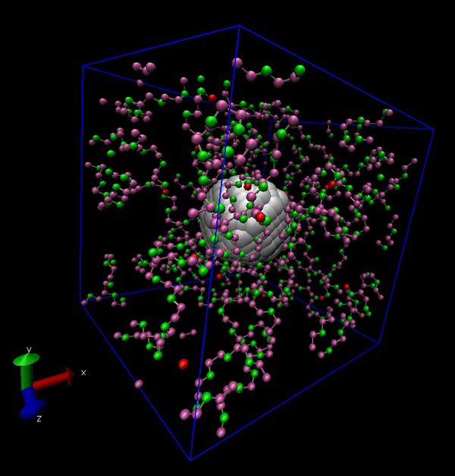

Slide 5
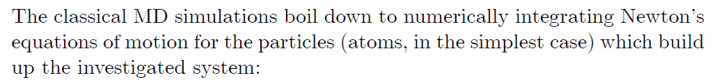
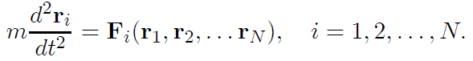
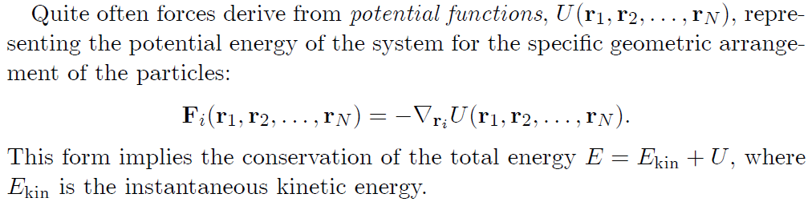

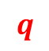
Basic Computation
$$r$$
In some context, we use instead of .
$$q$$

Slide 6
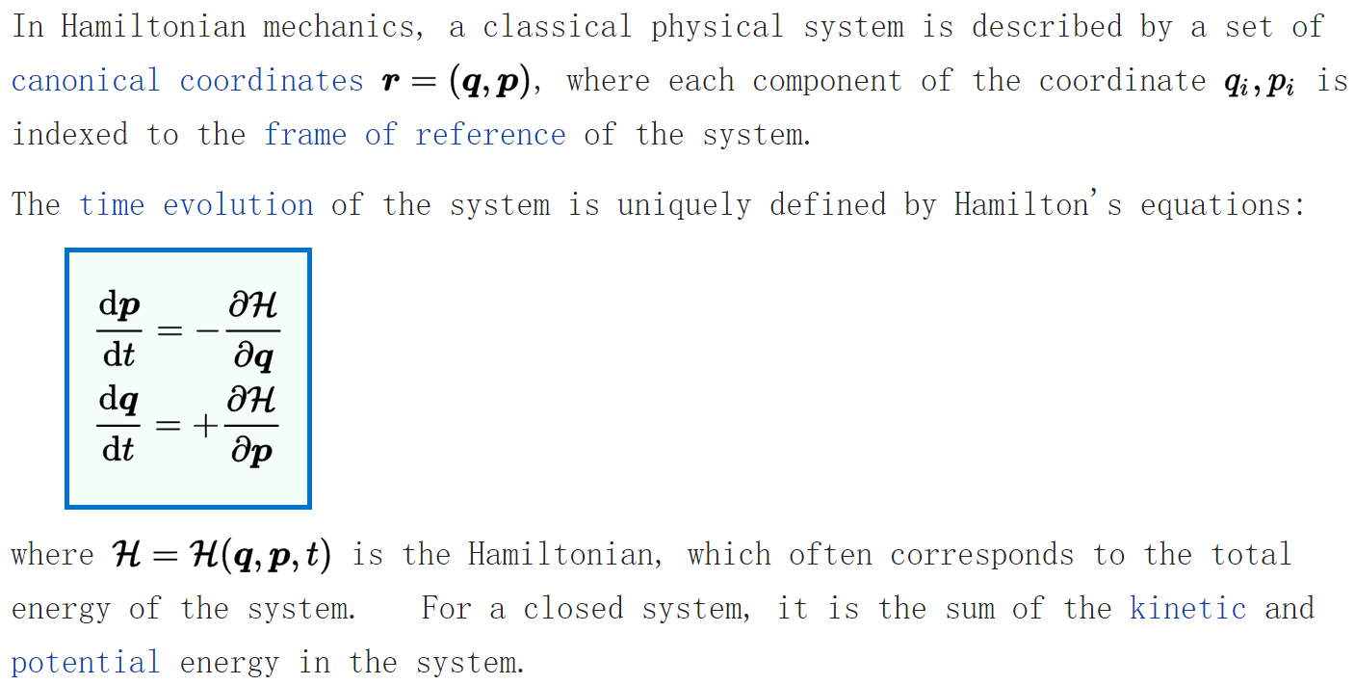
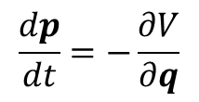
The fundamental reason is that the system is a Hamiltonian system
$$\frac{dp}{dt}=−\frac{∂V}{∂q}$$

Slide 7
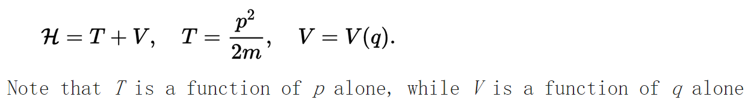
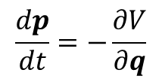
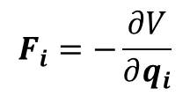
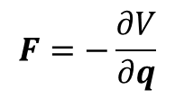
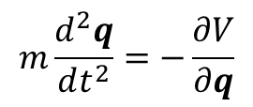
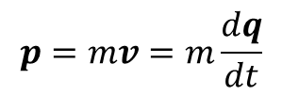
$$\frac{dp}{dt}=−\frac{∂V}{∂q}$$
$$p=mv=m\frac{dq}{dt}$$
$$m\frac{d^{2}q}{dt^{2}}=−\frac{∂V}{∂q}$$
$$F=−\frac{∂V}{∂q}$$
$$F_{i}=−\frac{∂V}{∂q_{i}}$$

Slide 8
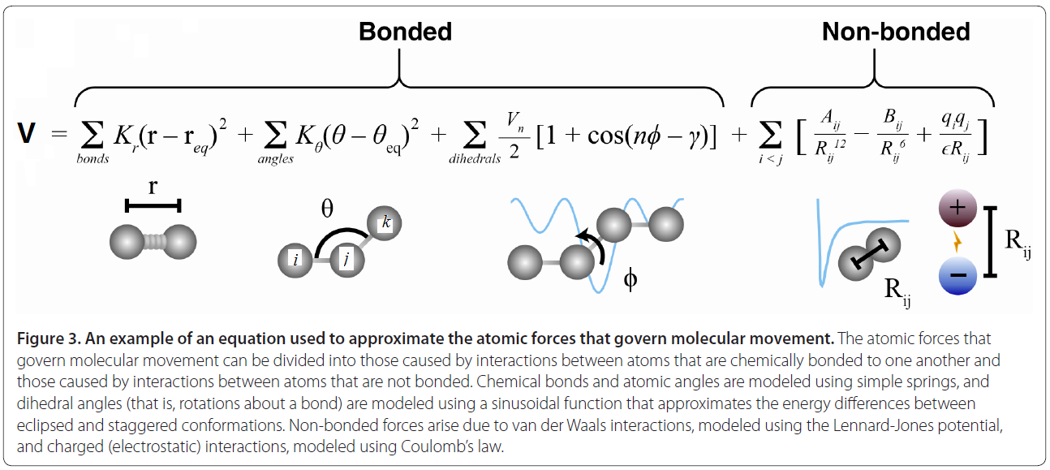
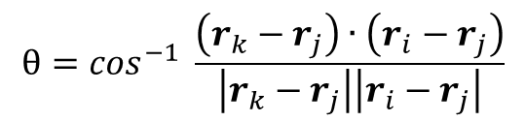
$$θ=\cos^{−1} \frac{\left(r_{k}−r_{j}\right)∙\left(r_{i}−r_{j}\right)}{\left|r_{k}−r_{j}\right|\left|r_{i}−r_{j}\right|}$$

Slide 9
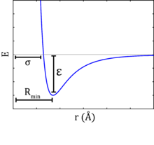
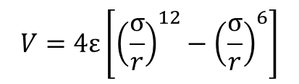
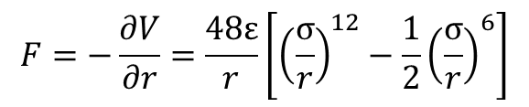
Example
r
Given that the potential between
the two neutral atoms are:
$$V=4ε\left[{\left(\frac{σ}{r}\right)}^{12}−{\left(\frac{σ}{r}\right)}^{6}\right]$$
Quiz
What is V when r = infinity?
What is V when r = σ ?
What is V when r = 0 ?
What is the force acting on the yellow atom ?
$$F=−\frac{∂V}{∂r}=\frac{48ε}{r}\left[{\left(\frac{σ}{r}\right)}^{12}−\frac{1}{2}{\left(\frac{σ}{r}\right)}^{6}\right]$$
Answer
0 0 ∞

Slide 10
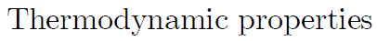
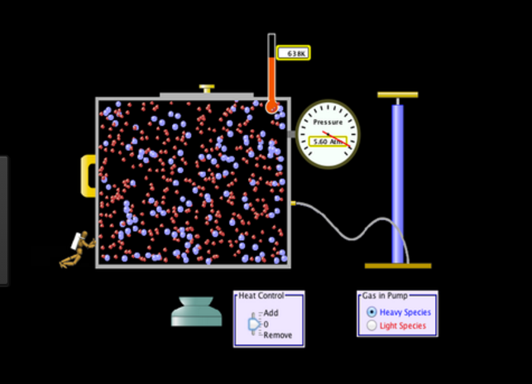
In usual scientific researches,
thermodynamic properties
(such as temperature and pressure)
are given as conditions.
In MD simulations,
It is the set of atoms that is given as the starting condition.
Thermodynamic properties usually need to be calculated from the simulation.

Slide 11
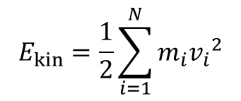
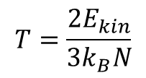
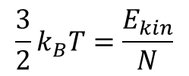
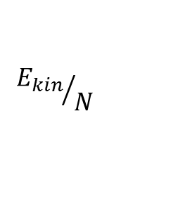
Temperature
It measures kinetic energies of individual atoms.
It is actually averaged kinetic energy.
1. First we calculate the total kinetic energy
$$E_{kin}=\frac{1}{2}\sum_{i=1}^{N}{m_{i}{v_{i}}^{2}}$$
2. Then we divide N to get the average kinetic energy
$${E_{kin}}/N$$
almost
3. It is the temperature T
$$\frac{3}{2}k_{B}T=\frac{E_{kin}}{N}$$
$$T=\frac{{2E}_{kin}}{3k_{B}N}$$

Slide 12
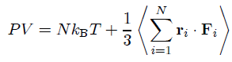
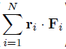
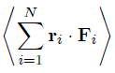
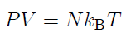
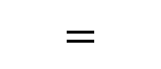
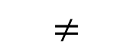
Pressure
Where <> represents “the expectation”
For example, <T> means the average temperature.
$$≠$$
N
+ …
$$=$$
M
For ideal gas,
= 0,

Slide 13
Molecular Dynamics Simulation
Periodic Boundary Condition (PBC)

Slide 14

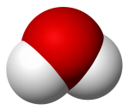

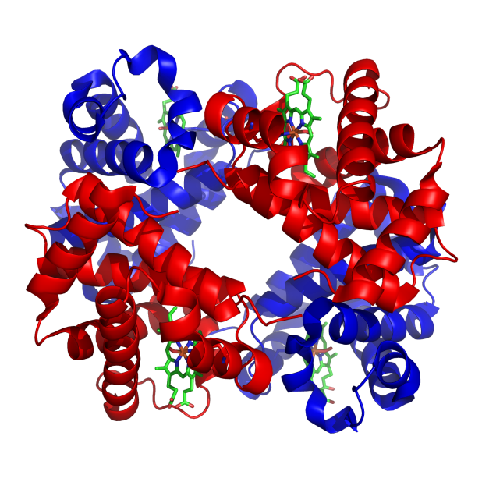
Why using PBC?
Plenty of water
One
macromolecule

Slide 15
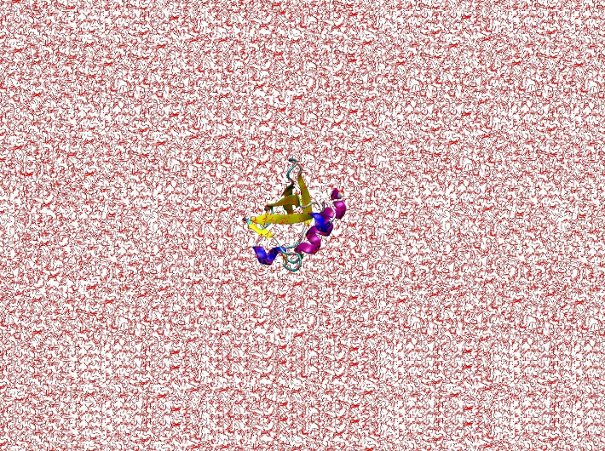
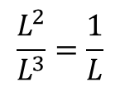
Because there is always a boundary.
And dynamics at the boundary is dramatically different from the inner dynamics.
L
If L is large, then boundary effect is relatively small and can thus be ignored.
$$\frac{L^{2}}{L^{3}}=\frac{1}{L}$$

Slide 16
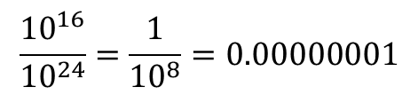
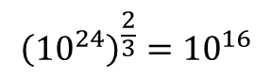
Macroscopically observable water should be sufficient.
For example, 18 grams of water + 1 protein
$$6.02×{10}^{23}$$
$$water molecules!$$
About how many water molecules in the boundary?
$${\left({10}^{24}\right)}^{\frac{2}{3}}={10}^{16}$$
What is the percentage?
$$\frac{{10}^{16}}{{10}^{24}}=\frac{1}{{10}^{8}}=0.00000001$$
Conclusion: The boundary effect can be ignored

Slide 17
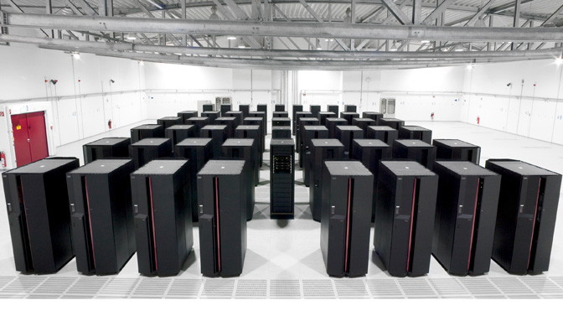
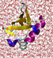
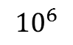
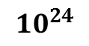
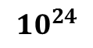
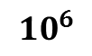
$${10}^{24}$$
But, can we simulate a system with water molecules?
No Way!
The typical number of particles which can be handled in MD simulation
nowadays is of the order
$${10}^{6}$$
$${10}^{24}$$
$${10}^{6}$$

Slide 18
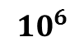
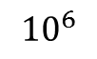
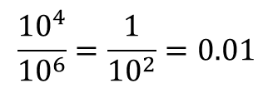
$${10}^{6}$$
But, is the boundary effect ignorable for a system with only water molecules?
$${\left({10}^{6}\right)}^{\frac{2}{3}}={10}^{4}$$
Water molecules in the boundary:
Water molecules in total:
$${10}^{6}$$
$$\frac{{10}^{4}}{{10}^{6}}=\frac{1}{{10}^{2}}=0.01$$
Percentage:
Conclusion: The boundary effect cannot be ignored

Slide 19
Solution:
Periodic Boundary Condition
It is an infinite system
(no boundary effect)
2. Although infinite,
Computation is finite
Just consider atoms
in the original box.
$${10}^{6}$$
Other atoms just copy
3. What is the role played
by other atoms?
They replace atoms
in the box (此入彼出)
They may exert force to
atoms in the box

Slide 20
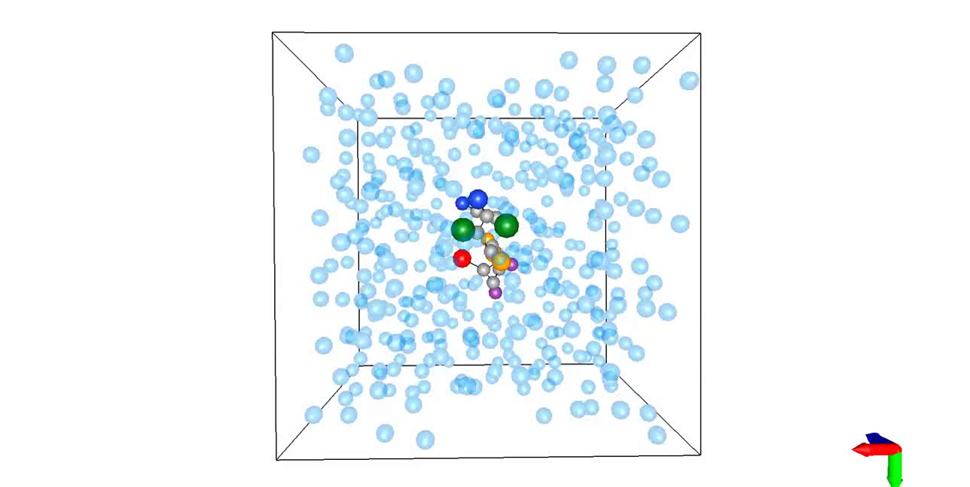

Slide 21

Solution: Periodic Boundary Condition

Slide 22
Particles in the box are mentally replicated to
infinity by rigid translation in all the three
Cartesian directions, completely filling the space.
2. All the “image” particles move solidary with their
“original” particle from the simulated box.
When a particle enters or leaves the simulation
region, an image particle leaves or enters this
region, such that the number of particles from the
simulation region is always conserved.
3. Only particles in the box are simulated.
Other particles just copy.
Question: which particle needs I to calculate force on it?
4. How to calculate the force? There are so many particles acting on it!!!
5. Use a cut-off circle with radius R.

Slide 23

A trick:
By carefully choosing the radius R,
only one image particle locates within the circle.
out
out
The particle within the circle
is not necessarily the one in the simulation box.
in
out
consider only the closest and neglect the rest
Criterion for choosing R
$$2R<L$$
L

Slide 24
6. The surface effects are thus virtually eliminated
(because the system is essentially infinite)
7. What really amazing is that:
Although the system is infinite,
one needs only to calculate N particles.
Others just copy.

Slide 25
Molecular Dynamics Simulation Software

Slide 26




Illustration
…
Simulation
AMBER

Slide 27

MD Simulation Software
http://www.ks.uiuc.edu/Research/namd/

Slide 28

MD Simulation Software
http://www.gromacs.org/

Slide 29

MD Simulation Software:
AMBER: Assisted Model Building and Energy Refinement
http://ambermd.org/

Slide 30


Slide 31



Example 1：build the following molecule in the preparatory
program called xLEaP for simulation in AMBER
1. Start xLEaP now with the xleap command
Note that the ">" indicates the command line in xLEaP.

Slide 32

2. source (load) a force field
a set of parameter and equations for
use in molecular mechanics simulations
Name of the force field

Slide 33


3. Use sequence to create a new unit called foo out of the ACE, ALA, and NME units.
4. Use the edit command to view the structure.
Notes:
ACE: N-terminal acetyl capping group
NME: C-terminal amide capping group

Slide 34

5. Solvate the system with the solvatebox command.
Solvate the molecule by adding TIP3P water molecules
TIP3PBOX specifies the type of water box to solvate with.
10.0 indicates that the molecule should have a buffer of at least 10 Angstroms between alanine dipeptide and the periodic box wall.
MD simulation is performed under PBC

Slide 35



6. Use the saveamberparm command to save the prmtop and inpcrd file
Prmtop: parameter/topology file
You need not to
know details
……

Slide 36

Inpcrd: coordinate/restart file
Atom 1
Atom 2
……

Slide 37

6. To quit xLEaP use quit.
All the above steps are just for preparation
Now let’s get into the real meat.
Minimization
2. Heating with constant volume and temperature (NVT) for 20ps from 0K to 300K
3. Production MD with constant pressure and temperature (NPT) at 300K and 1atm for 60ps

